Slide 1
College and Financial Aid
Agenda:
College Process Recap
Junior Seminar Outline
Financial Aid 101

Slide 2
College Process
Counselor’s Role:
Help students find colleges that match current interests and abilities or “best fit”
Help create a balanced list
Provide answers to questions along the way
Help facilitate family communication
Encourage students to take primary responsibility for the process

Slide 3
College Process
SAT Test Dates:
May 4th
June 1st-register by May 3, late May 22
August 24th-register by July 26, late August 13
October 5-register by September 6, late September 24
ACT Test Dates:
June 8th-register by May 3, late May 20
September 14th-register by August 16, late August 30
October 26th-register by September 20, late October 4

Slide 4
College Process
Applications:
Applications aren’t available until August 1 of a student’s senior year
There are several pieces of the application:
Transcript
GPA
Test Scores
Honors / Awards
Extra-curricular activities
Leadership roles
Community involvement / service
Summer experiences
Jobs / Internships
Disciplinary / Attendance Concerns
Letters of Recommendation
Essay

Slide 5
College Process
The Common Application
Many schools participate in the Common Application and it’s linked to Naviance. For each school that participates, you will be able to apply via your one application. Some schools will require a supplement (additional essay) or two along with the basic Common App.
You can apply to up to 20 schools via your Common Application. No one should be applying to 20 schools. It is way too many.

Slide 6
College Process
Other Applications
The SUNY Application
Similar in concept to the Common Application, but for SUNY (State University of New York) schools. ALL SUNY schools use the Common Application.
The CUNY Application
Once again, like the Common App and the SUNY App, but for CUNY (City University of New York) schools. You can apply to multiple CUNY schools using one application.
The Coalition Application
Another application similar to CA, schools that use Coalition are not typically on the CA. Not as user friendly, require a different essay.

Slide 7
College Process
When should applications be completed?
ALL SENIORS ARE STRONGLY URGED TO COMPLETE THE COLLEGE APPLICATION PROCESS PRIOR TO THE DECEMBER BREAK. MEANING, YOU SHOULD HAVE SUBMITTED ALL OF YOUR APPLICATIONS AND TRANSCRIPT REQUEST FORMS BY DECEMBER 15TH.

Slide 8
College Process
What are students responsible for?
Application and fee
Essay and any supplemental essays
FAFSA & CSS Profile if applicable
Asking for teacher recommendations
Two – from core academic teachers
Students will ask teachers to write these for you, and they will upload them into Naviance. We will be responsible for sending them out. But remember: students are responsible for finding teachers who will write them and following up to be sure that they have done so.
SAT and or ACT test scores.
Students are responsible for requesting these from the College Board and/or ACT. Students must submit a request to have these sent to the colleges to which they are applying.

Slide 9
College Process
What are WE responsible for?
Counselor recommendation
School Profile
Initial transcript
Mid-Year transcript
Final transcript (which will never get there if you don’t tell us where you have decided to attend)

Slide 10
Junior Seminar
What we’ve been doing:
Going down to year meeting to discuss the college process
Logged onto Naviance to begin building their college list
Utilized College Board’s Big Future site to research and find colleges that match interests and criteria

Slide 11
Junior Seminar
May and June:
The College Essay
Letters of Recommendation
Continuing the college search and creating a formal list

Slide 12
Financial Aid Basics

Slide 13
What Is Financial Aid?
Financial aid consists of funds provided to students and families to help pay for postsecondary educational expenses.
Need Based Aid / Merit Based Aid

Slide 14
Federal Government
State Government
School/Colleges
Private Scholarship Sources:
HS counselors
Clubs and organizations
Employers
Internet scholarship searches

Slide 15
The Financial Aid Process
Page 10 PA Student Aid Guide
Know what financial aid forms each school requires
ALL Schools Require:
FAFSA (Free Application for Federal Student Aid) after October 1 for 2017
Required by all schools, and some scholarship organizations
STATE GRANT FORM (TAP)
Required for first-year students after FAFSA is completed
SOME Schools and Scholarship Organizations Require:
CSS PROFILE
Own Financial Aid worksheets
Notes:
The CSS PROFILE is a form from College Scholarship Services. It must be submitted in addition to the FAFSA, but ONLY if a school (typically private colleges) or a scholarship organization requires it.
The CSS PROFILE gathers supplemental financial and family information and is available online at www.CollegeBoard.com under students, then Pay for College.
There is a $9 registration fee, plus a fee of $16 for EACH SCHOOL or scholarship organization listed on the form. A limited number of fee waivers are granted automatically to first-year, first-time citizen — or eligible non-citizen applicants — from low-income families, based on the financial information provided on the PROFILE.
Contact the schools you are applying to, to see if this form is required!
Some schools have their own institutional financial aid application that must be submitted in addition to the FAFSA. Information is usually available online, at a school’s web site, explaining what financial aid applications are needed to be completed by the applicant.
It is the responsibility of the student to complete all required applications and return them to the school in a timely manner. Please note that often schools require separate applications for non-need based financial aid. For example, many schools have a separate application process and deadline for academic scholarships.

Slide 16
CSS PROFILE
Collegeboard.org
Submit if required in addition to the FAFSA

Slide 17
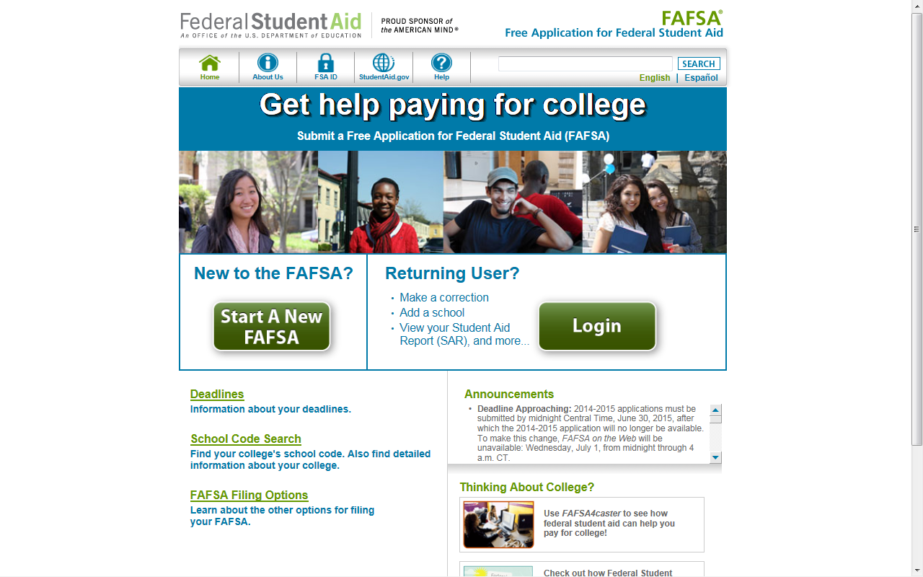
FAFSA – Free Application for Federal Student Aid
FAFSA.gov
Must file a FAFSA to be eligible for these programs each year a student attends school
File online – Fast, Secure, Skip Logic, Built-in Edits, Start/Save/Stop

Slide 18
Deadlines Are Crucial
Make sure you know the priority FAFSA filing deadlines for the schools you are considering.
File your FAFSA prior to the earliest deadline, even if you have to estimate your information. If you estimate, you must update the FAFSA later.

Slide 19
Deadlines
NY State deadline –
June 30, 2020
The earlier, the better!

Slide 20
Basic Principles
Paying is the joint responsibility of the student and parent(s), to the extent possible.
Need-based financial aid is subject to a federal formula to determine financial need.
Not all families qualify for need-based aid. There is no guarantee that you will get any free money to pay for higher education.

Slide 21
Whose Info Goes on the FAFSA?
Divorced or separated parents (The parent the student lived with the most over the past 12 months. If equal, then the parent who provided more than 50% of student’s support)
Stepparents - YES
Adoptive parents - YES
Foster parents - NO
Legal guardians - NO
Anyone else the student is living with - NO

Slide 22
Info You May Need to Complete the FAFSA:
Social Security Numbers
Driver’s license (student only; this information is optional)
Previous year’s federal income tax return (1040, 1040A or 1040EZ)
W-2 forms from all employers
Current bank statements (checking and savings)
Current business and farm records (if >100 employees / if you don’t live on the farm)
Records of any stocks, bonds and other investments, including 529 accounts (Net amounts)
Additional untaxed income, tax records may be needed such as: Veteran’s non-educational benefits, child support paid/received, workers’ compensation, disability payments
Alien registration or permanent resident card (if not a U.S. citizen)
Notes:
Information concerning income and assets is needed in order to complete a FAFSA. Please note if an applicant uses the FAFSA-IRS Data Retrieval Process, they may not need to have an actual copy of a tax return with them to complete the FAFSA.

Slide 23
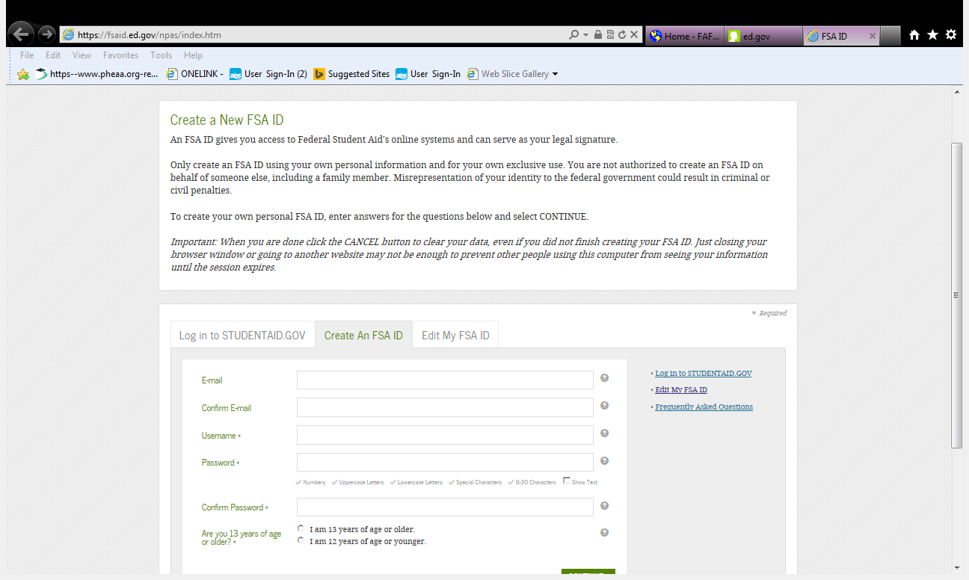
Signing the FAFSA
NEW - Replaces the “PIN” as of 5/10/15
Student and one parent will sign the FAFSA electronically - each needs a SEPARATE email address and ID/password
Create FSA ID at:
www.FSAID.ed.gov
or at FAFSA.gov
FSA ID 3 days in advance

Slide 24
Electronic Signature:
You’ll use it again for:
Renewal FAFSA
FAFSA status and corrections
Signing a Direct Loan Master Promissory Note (MPN)
Complete required entrance and exit loan counseling
Review loan history at NSLDS.ed.gov
A FAFSA IS NOT COMPLETE UNTIL SIGNED!
Page 10 PA Student Aid Guide

Slide 25
FAFSA Confirmation Page
Apply for your State Grant from the FAFSA Completion/Confirmation page
Start your state application to apply for New York state- based financial aid
Transfers FAFSA data to the State Grant Application/TAP

Slide 26
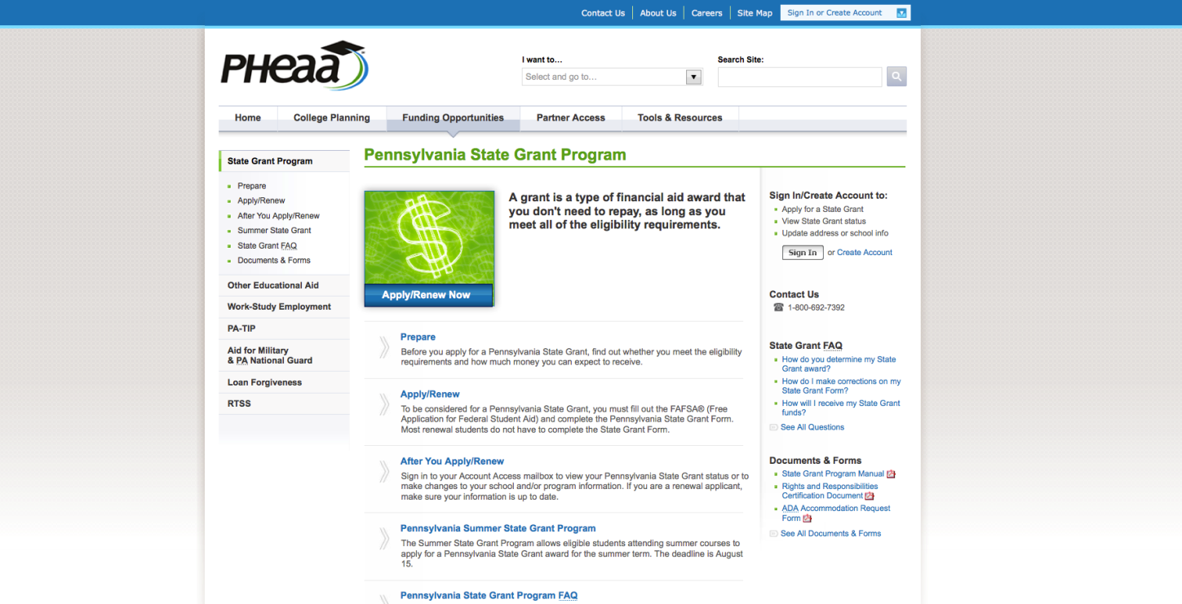
Online State Grant Application
Link off the FAFSA Application Confirmation Page
Missed the link or it wasn’t available?
Head to https://www.tap.hesc.ny.gov/totw/
Additional questions needed to determine NY State Grant eligibility:
Enrollment status (full-time/part-time)
Value of NY 529 College Savings Program
Program of study for students in vocational programs
Employment status
OR

Slide 27
IRS Data Retrieval Tool (DRT)
The IRS Data Retrieval Tool allows students and parents to access IRS tax return information needed to complete the FAFSA. Students and parents may transfer the data directly into their FAFSA.
IRS Data is available:
After 2 weeks of electronically filing federal tax return
After 8 weeks of filing a paper federal tax return
If student used estimated income to complete FAFSA, can go back once taxes are filed and use IRS Data Retrieval Tool.

Slide 28
Forms Are Filed – Now What?

Slide 29
What Happens Next?
Student Aid Report or Acknowledgment sent to student (review and make necessary corrections)
Information is sent to schools/colleges. Sent to all schools student lists on the FAFSA.

Slide 30
Need Analysis is Calculated by Schools
Schools use SAR calculations to determine a student’s financial need based on:
Two Components:
The student’s Cost Of Attendance
The student’s Expected Family Contribution (EFC)
Notes:
What’s the cost to attend here, and how does your EFC factor into calculations for internal and federal aid the school offers to help you pay for college.

Slide 31
Cost of Attendance
Page 7 PA Student Aid Guide
The Financial Aid Office will include the direct costs in determining the student’s annual cost of attendance at that school:
Direct College Costs:
Tuition
Required Fees
Room
Meals
Books and Supplies
Indirect College Costs:
Transportation
Personal Expenses
Dependent Care Expenses
Dorm Furnishings
Notes:
At each school that you apply to, your EFC will remain the same but your cost of education will be different. Schools may consider both direct costs, charged by the school and indirect costs, that the student pays outside of school.
Costs vary greatly from school to school. In evaluating college costs, students must be sure to compare similar expenses. They should not consider tuition and fees only at one school and all costs at another school.
In preparing to meet the cost of attendance, families should distinguish between direct costs to be paid to the institution (tuition and fees, room and board, books and supplies) and those indirect costs over which they may have more control (transportation costs and personal expenses).

Slide 32
Expected Family Contribution (EFC)
The EFC is a number derived from a federal formula which considers a family’s income, assets.
In theory, the EFC is the amount a family can reasonably be expected to pay toward college expenses each year.
In reality, it is not the amount a family is required to pay and it is rarely the amount a family actually pays.

Slide 33
Federal and State Aid

Slide 34
Federal Programs
Pell Grant (2018-19 max award $6,095)*
Campus-based aid
Federal Work-Study…… FAO determines
Perkins Loan…………….some schools offer
For most programs, student must be enrolled at least half-time.

Slide 35
Financial Aid Award Letter
Official notification from school about financial aid, terms and conditions
Lists the type and amount of each award to be received
Describes what must be done to accept or reject any award
Discloses students rights, responsibilities and academic requirements

Slide 36
Financial Need
Your financial aid package may not meet all of your calculated financial need.
Be sure to determine how much will be required of you in out-of-pocket costs and loans.

Slide 37
Ways to Reduce the Need for Financial Aid
Graduate on Time
4 year for bachelor’s degree / 2 year for associate’s degree
Research and find the right school and major
Minimize transfer and change of major
Earn college credits while in high school through AP courses, vo-tech and dual enrollment
Consider options for cutting costs (take summer classes, buy used books, make smart meal plan choices)
2 + 2 Strategy (2 years at a community college then transfer credits to a 4-year school)
3 + 2 (master’s degree)

Slide 38
What Can You Do Now?
Student and parent apply for an FSA ID at:
StudentAid.ed.gov/fsaid
Visit websites with free information about college, financial aid and careers
Explore scholarship opportunities – locally, regionally and nationally
Use the free online tool, FAFSA4caster, to estimate EFC and eligibility for federal financial aid
Available at fafsa.gov
Use the Net Price Calculator of prospective schools to get an estimate of your “net price” to attend

Slide 39
Special Circumstances
If things change…
Divorce or Separation
Stepparents
Adoptive parents
Foster parents
Legal guardians
Living with others
Recent death or disability
Reduced income
Medical expenses
…Notify the Financial Aid Officer at school choice

Slide 40
Be a Smart Consumer
Do your research…
What is the Net Price that you will pay? Use the Net Price Calculator at schools student is interested in attending to get an estimate of your “net price” to attend. Net Price calculator available on each school’s website.
What is the graduation rate?
What is the average debt of graduates?
What is the repayment rate and default rate of the school’s borrowers?
What is the employment outcome for recent graduates?

Slide 41
Types of Scholarships
Postsecondary (in-house) scholarships
Local and regional scholarships
National scholarships

Slide 42
QUESTIONS?

